Slide 1
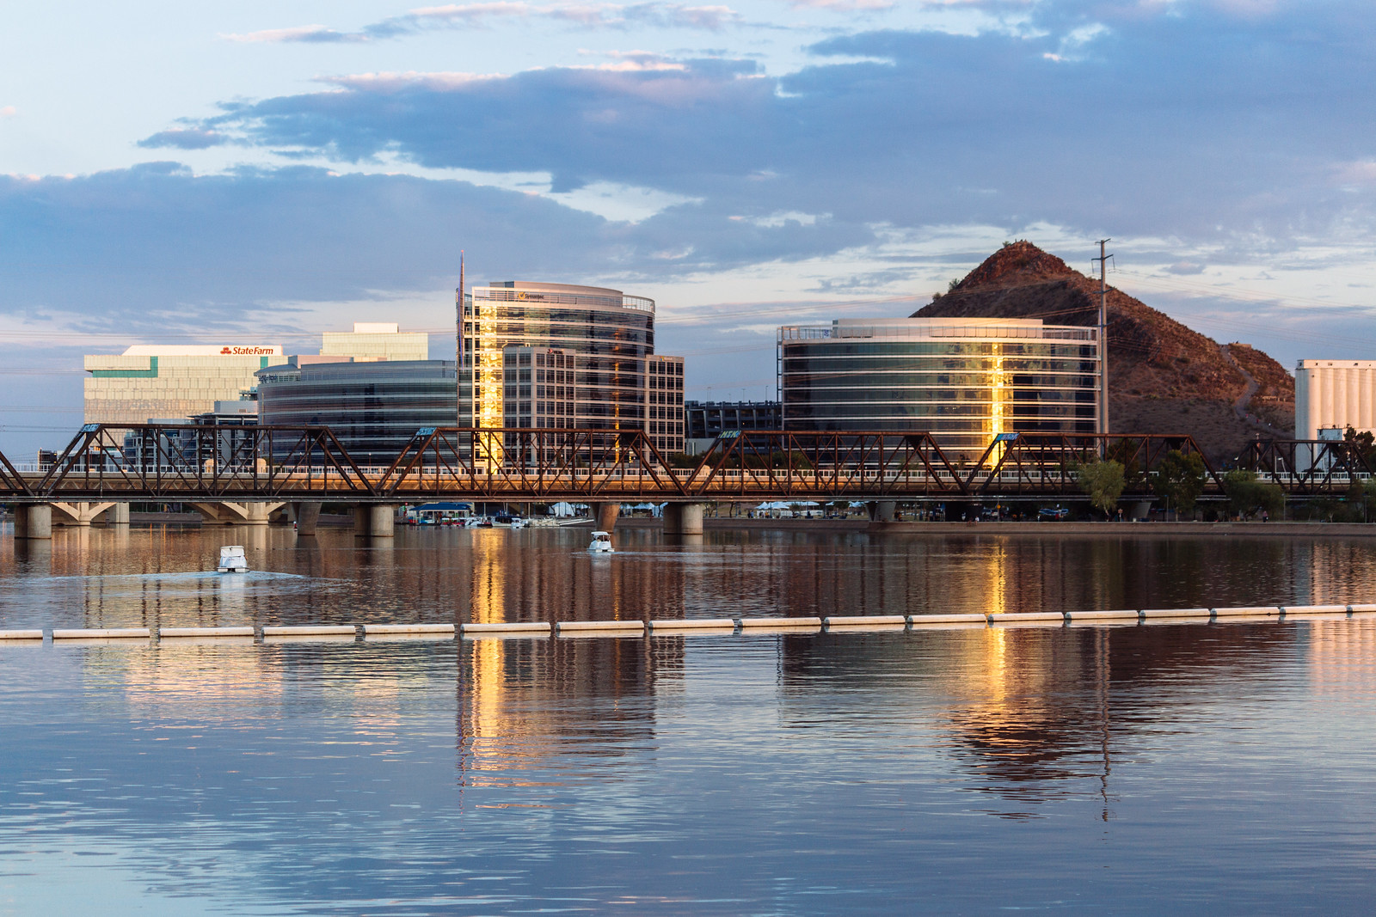

Region X CRC
Phoenix, AZ
Chapter Finance
& Risk Management
Jacob Brausch
Region X Regional Treasurer
jake@region.org – (916) 542-5728

Slide 2






  Treasurer Resources
  Chapter Finance Overview
  Treasurer Responsibilities Throughout the Year
Agenda
  Insurance Requirements
  Risk Management
  Important Notes

Slide 3
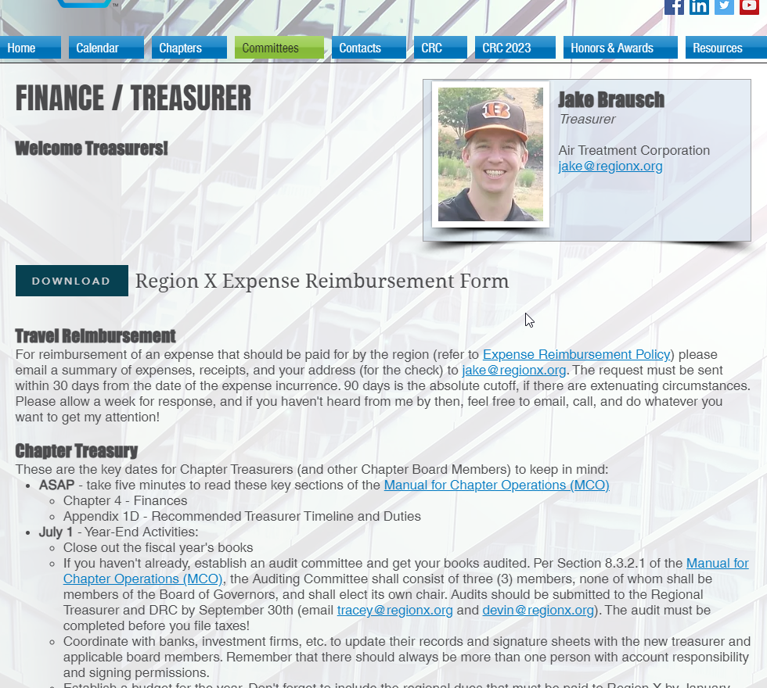
Treasurer Resources
Your #1 Resource
ASHRAE Manual for Chapter Operations
https://www.ashrae.org/communities/chapters
  Section 1.5: Treasurer
  Chapter 4: Finances
  Appendix 1D: Recommended Treasurer Timeline and Duties
Also, me, everyone in this room, and the Region X Treasurer Page: https://www.regionx.org/finance

Slide 4

Chapter
Finance Overview

Slide 5
Fiduciary Duties
As a Chapter Officer you have a Fiduciary duty to your ASHRAE Chapter.
Fiduciary- “A person who has the power and obligation to act for another…under circumstances which require total trust, good faith and honesty.”
Board members must act in accordance with the organization’s mission, charter and bylaws, and any applicable state of federal laws.
Board members who violate these duties may be held personally liable for any financial harm the organization suffers as a result.

Slide 6
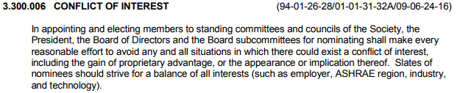
Avoiding Conflicts of Interest
One of the most important components of the duty of loyalty is the obligation to avoid conflicts of interests.
Step aside or abstain from voting when ever there is an appearance of a conflict of interest
Please review the ASHRAE Codes of Ethics

Slide 7
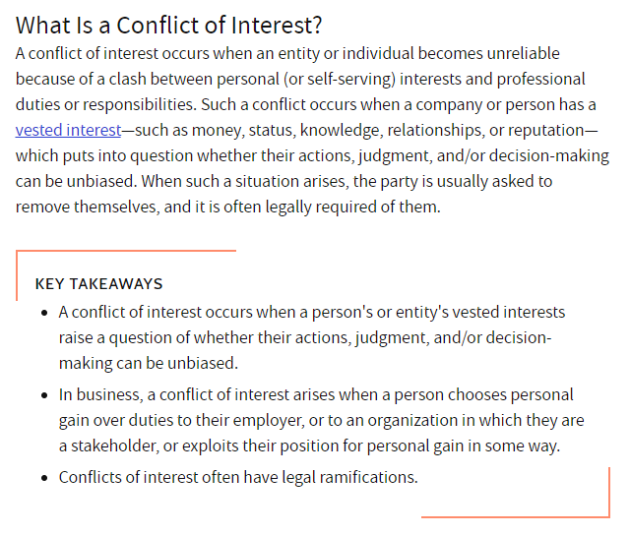
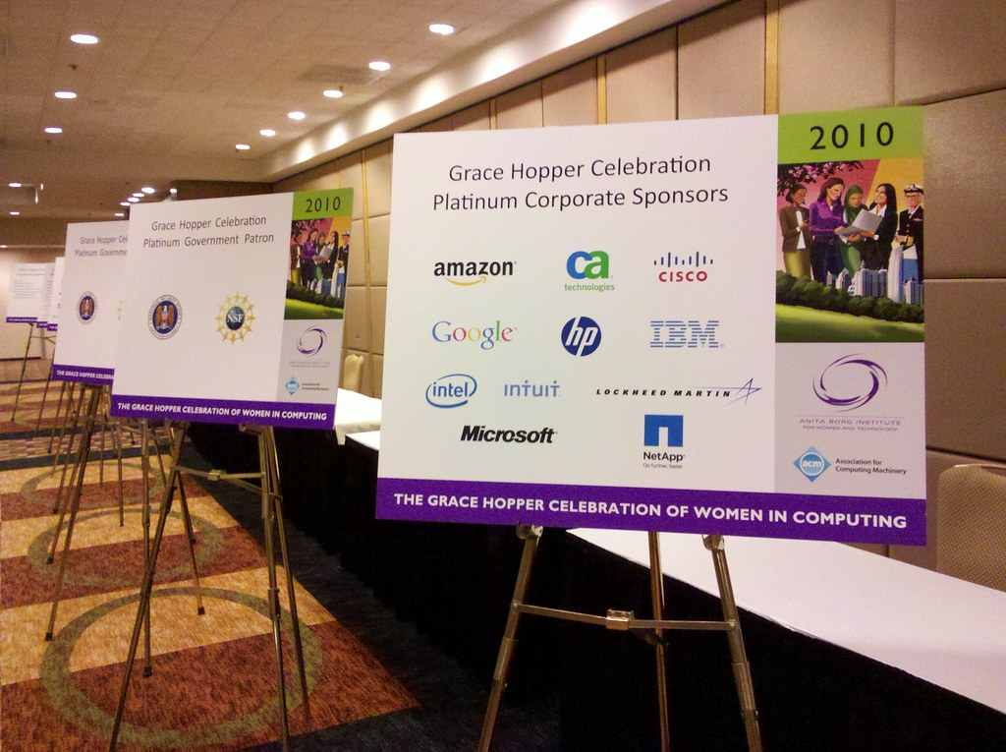
Avoiding Conflicts of Interest
This Photo by Unknown Author is licensed under CC BY-ND
Source: Investopedia.com

Slide 8
Chapter Treasurer Duties
Make deposits and issue checks authorized by the BOG
Balance/Reconcile monthly statements and present to BOG for review and approval
Keep financial records
  Chapter Account used for Operations Only
  Use Separate Accounts for Special Events such as CRC Fund or Scholarships
  Other special accounts?
File Taxation and Revenue Reports
Be aware of scams

Slide 9
Financial Accounting and Banking Best Practices
Each Chapter should use reputable financial software
At least three Chapter officers should have signature authority
  How does your chapter provide transparency and oversight on larger checks?
Debit Cards ……. convenient, but dangerous
Chapter should have separate accounts for high dollar special events
When possible, Research Donations should be forwarded directly to ASHRAE Research
Investments should be in safe low risk investments (i.e. bonds or term deposits), the ASHRAE Foundation or a Chapter Foundation

Slide 10

Treasurer Responsibilities Throughout the Year
July 1, 2024 – Year-End Activities

Slide 11
Establish a Budget for 2024-25
  More than a financial base, it is a map of the current philosophy of the Board of Governors. The budget shows the chapter's goals and intentions for the coming year.
  Maintain a file with the notes and calculations used in determining budget line items for future reference. The information in this file will be invaluable when comparing actual versus estimated income and expenses and when preparing the next year's budget.
  Budgets should be designed to be balanced. That is, estimated expenses should equal estimated income.
  Budgets should be conservative, with overestimated expenses and underestimated income.
  Don’t forget to include the regional dues that must be paid to Region X by January 30th. Final amount determined by approved CRC budget.

Slide 12
Year End Activities
Transfer Accounts & Close Books
Coordinate with banks, investment firms, online accounts, etc. to update their records and signature sheets with the new treasurer and applicable board members. Remember that there should always be more than one person with account responsibility and signing permissions.
Close out the 2023-24 fiscal year books.
If you haven’t already, establish an audit committee and get your books audited. Per Section 8.3.2.1 of the Manual for Chapter Operations (MCO), the Auditing Committee shall consist of three (3) members, none of whom shall be members of the Board of Governors, and shall elect its own chair. Audits should be submitted to the Regional Treasurer and DRC by September 30th, 2024 (email jake@regionx.org; buzz@regionx.org). The audit must be completed before you file taxes! (July 30, 2024 for PAOE points)
September 30, 2024 – Final day to submit your audit reports to the Regional Treasurer and DRC (email jake@regionx.org; buzz@regionx.org). Refer to MCO Appendix 1C for a sample letter. Technically, this should have been done within the month of July, but we realize many treasurers may not know about the requirements until after the CRC.

Slide 13
Filing Taxes
November 15, 2024
Deadline for tax filing
What happens if you
don’t file or file late
Info Needed
for Tax Filing
There are penalties for chapters not filing both federal and state taxes as required. Fines!
Chapters can lose their tax-exempt status.
Society can also be at risk when chapters lose their non-profit status.
Society could decide to dissolve the chapter. Too much risk to Society.
Employee Identification Number (EIN) or Taxpayer Identification Number (TIN)
Legal name (ASHRAE Chapter Chartered Name) and any alternative name organization uses
Mailing address
Name and address of principal officer for year in question (Usually the Chapter President)
Confirmation of annual gross receipts.
WORK WITH YOUR PREVIOUS TREASURER/PRESIDENT!
Federal Tax Returns
State Tax Returns (for applicable states)
State forms/fees for verification of non-profit status (for applicable states)
Please submit a copy of these items to jake@regionx.org

Slide 14
Federal Taxes
Status | Form to File
Gross receipts normally ≤ $50,000 Note: Organizations eligible to file the e-Postcard may choose to file a full return | 990-N (e-Postcard)
Gross receipts < $200,000, and Total assets < $500,000 | 990-EZ or 990
Gross receipts ≥ $200,000, or Total assets ≥ $500,000 | 990
Private foundation - regardless of financial status | 990-PF
Gross Receipts: The gross amount received by the organization during its annual accounting period from all sources without reduction for any costs or expenses including the costs of goods or assets sold; cost of operation, expenses of earning, or collecting such amounts. Gross receipts include, but are not limited to, the gross amount received from contributions, gifts, grants and similar amounts; the gross amount received as dues or assessments from chapter members or affiliate organizations; the gross sales or receipts from business activities (whether or not it relates to your exempt purpose); the gross amount received from the sale of assets; and, the gross amount received as investment income.

Slide 15

Info Needed for e-Postcard
Employee Identification Number (EIN) or Taxpayer Identification Number (TIN).
Tax Year
Legal name. (ASHRAE Chapter Chartered Name)
Alternative name organization uses.
Mailing address.
Name and address of principal officer for year in question.
(Usually the Chapter President)
Confirmation of annual gross receipts.

Slide 16
State Taxes & Non-Profit Filings
California
Hawaii
Nevada
State Taxes – Forms 199 or 199N (e-Postcard), 109
California Attorney General – Form RRF-1 with copy of Federal Tax Return and fee
California Secretary of State – Form SI-100 (e-file) and fee
  Appears to only be if changes have occurred since previous filing *Need to confirm*
  Change would include change of Board
Hawaii Dept. of Taxation (State Taxes)
Hawaii Dept. of Commerce and Consumer Affairs – Annual Report and fee ($5)
  Due by the end of the quarter in which the organization was originally registered
Hawaii Attorney General – Hawaii Charity Annual Transmittal Form & copy of Federal Tax Return +fee
Nevada Secretary of State: Charitable Solicitation Registration Statement & Annual List of Officers
  Work with URS Compliance for registration – society pats for fee in states in which a chapter has 3 or more AAM’s. Chapter responsible to pay for state fees and penalties/fines for current or past years.

Slide 17
Important Dates
Jan 30, 2025
Deadline for paying regional dues. Please send check, made out to "ASHRAE Region X" to Jacob Brausch at the address listed here:
3261 Sunny Gate Lane
Attn: Jacob Brausch/ASHRAE Region X
Folsom, CA 95630
Jan 31, 2025
Form 1099-MISC (to anyone whom you have paid >$600 for services, prizes (not scholarships).
Spring 2025
Register next year’s Chapter Treasurer for the 2025 CRC!
April 2025
Get a head start on establishing your Audit Committee (discussed in previous slides).
Jun 30, 2025
Final day of 2024-2025 ASHRAE Year. Time to close-out the books.

Slide 18

Insurance Requirements

Slide 19
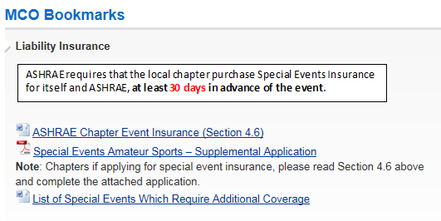
Insurance
ASHRAE provides Comprehensive General Liability insurance for chapters in the U.S. and Canada only. It is not necessary for these chapters to obtain their own general liability insurance. This policy has, as additional insured, all members of the chapters, but only with respect to their liability for activities of the ASHRAE chapter.
EXCEPTIONS - racing, skiing, firearms, anything with boats (i.e. fishing) or animals, contact sports, mechanical bulls and other activities. Local chapter must purchase Special Event Insurance for itself and ASHRAE, at least 30 days in advance of the event
https://www.ashrae.org/society-groups/chapters/manual-for-chapter-operations

Slide 20

Risk Management

Slide 21
Lotteries/Games of Chance
  Each state has its own laws regarding Lotteries
  Chapter Leaders should do their own research before asking anyone else to participate in an activity which may not be legal
  Requires registration. Only allowed for non-profits which have been established for >5 years; only members may participate.
  Only allowed when very specific requirements are met, including 90% of funds going to charity. Register with the Attorney General.
Arizona
California
  Requires state notification, <$2500/year total, net proceeds must go to a charity in the state.
  Gambling/Lotteries/Games of Chance are illegal.
Hawaii
Nevada
We’re not CPAs or lawyers but we have financial and legal resources available.

Slide 22





Have Any Doubts?
    Support When Managing Risk
    Questions Regarding Best Practices
Contact Your
Regional Treasurer
    Conflicts of Interest
  Can connect you with the right resources, especially anything regarding fiduciary responsibility, financial troubles, tax issues, or allocation of funds.
    Support with Funding Activities and Opportunities
    Keeping Chapter Finances on Track

Slide 23
Phishing Email Guidance
  If you receive an email that is from a Chapter President, Chapter Officer, Regional or Society Officer asking you to do something you don’t normally do (buy gifts, transfer money), it’s likely a scam.
  If money or sensitive information is involved… Guilty until proven innocent!
  Suggested actions:
    Don’t respond to the email.
    Contact the person face to face, if possible, to question the email or contact them via telephone.
    Do nothing until you can contact that person to confirm the request.
    If you send money and are scammed, contact your company or if no policy is in place:
    Contact your bank immediately.
    Contact law enforcement.
    File a complaint.
    Brief the BOG and Regional Leadership.

Slide 24
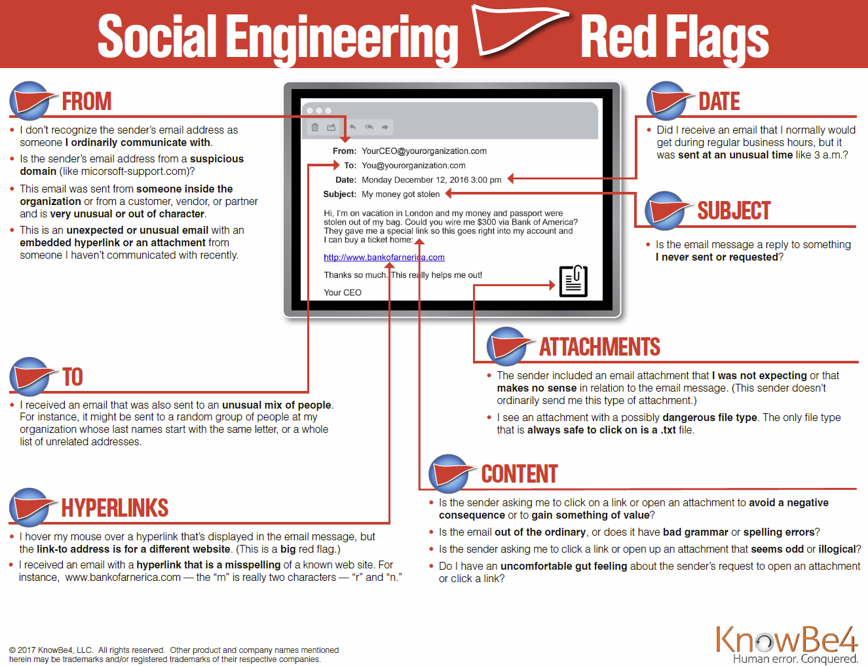

Slide 25

Important Notes

Slide 26
Additional Notes
Watch for scams and phishing emails/texts
Anyone can ask to review chapter or regional finances; our books are open
Spread out authority and make sure signature authorities are clear on all accounts.
Where possible all Research Donations should be forwarded directly to ASHRAE Research. Don’t hold. If the check has ASHRAE in the name, Society can deposit it.
All investments should be in safe low risk investments. (I.e. bonds, term deposits), in the ASHRAE Foundation or a Chapter Foundation.
ASHRAE Foundation
  Minimum $3,000 investment. 5% annual return in perpetuity allocated to RP, Education, YEA, Scholarships. Counts towards annual goals every year thereafter.
  Chapters with large bank accounts should consider donating and reducing account balance to a more reasonable amount.
  $30,000 min. for Chapter operated- or $60,000 for Society run- scholarship fund with 5 years to vest. $1,500/$3,000 annual scholarship

Slide 27
Open Discussion Topics
Region communication – Basecamp
  Region support, enough or need more, mid-year check-in?
  Office Hours w/ Buzz (DRC) and Colin (RMCR)
Is Treasurer part of chapter exec track?
  How long does Treasurer serve in your chapter?
Account balances
  A lot of high balances last year, what changes did your chapter make?
  Plans to utilize funds, invest, etc.?
  Investment accounts
    Private
    ASHRAE Foundation: Invest $30,000, guaranteed 5% payback annually in perpetuity ($1500/year), $60,000 -> $3,000, society level scholarship.
Questions, concerns, issues?

Slide 28
Budget Working Session

Slide 29
THANK YOU!
Jake Brausch
jake@regionx.org
(916) 542-5728
Sacramento, CA

